Slide 1
Writing an Abstract
Versant Annual Client Conference

Slide 2
Writing an abstract
Purpose and Outcomes of this Presentation
The purpose of this presentation is for the learner to develop the knowledge and skills needed to create and submit an abstract for a chosen conference.
Outcomes: After reviewing the presentation the participant will:
  Incorporate the abstract writing process and key elements for successful abstract writing
  Create and submit an abstract for Versant’s Annual Client Conference

Slide 3

Why Submit an Abstract?
Sharing Knowledge and Best Practices
The Nursing Professional Development Scope & Standards for Practice promotes the sharing of knowledge and best practices supporting lifelong learning and nursing professional development.
Notes:
Why submit an abstract? The next slides will correlate the commitment of sharing transition to practice program work and best practices with other organizations.

Slide 4
Nursing professional development
Scope & Standards of Practice
Standard 9: Evidence-based Practice and Research
Standard 13: Collaboration
Standard 16: Mentoring/Advancing the Profession
Notes:
To facilitate life-long learning, the Nursing Professional Development Scope and Standards of Practice have specific standards that focus evidence-based practice and research; quality of nursing professional development; leadership; collaboration; mentoring and advancing the profession. (Harper, M. & Maloney, P. (Eds.), 2016)

Slide 5
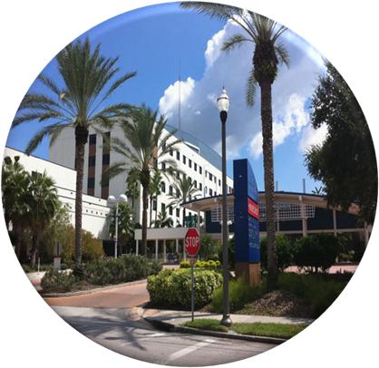
Nursing professional development
Standard 9: EVIDENCE-BASED PRACTICE (EBP) AND RESEARCH
“Champion of scientific inquiry, generating new knowledge, and integrating best available evidence into practice.”
“Disseminates research, EBP, and quality improvement findings through activities such as presentations, publications, and consultation.”
Notes:
Through the research process, the presenters incorporate evidence to guide the practice recommendations and decisions. These recommendations should align with the organizations strategic plan along with national standards and initiatives.
(Harper, M. & Maloney, P. (Eds.), 2016)

Slide 6

Nursing professional development
Standard 13: COLLABORATION
“Collaborates with interprofessional teams, leaders, stakeholders, and others to facilitate nursing practice and positive outcomes for consumers.”
“Develops partnerships and coalitions to enhance health care through interprofessional initiatives (e.g. quality improvement and organizational excellence initiatives).”
Notes:
Through collaboration there is an exchange of knowledge and research evidence, conference attendees have the opportunity to bring the information back to their organizations to facilitate decision-making for practice effectiveness and improvement.
(Harper, M. & Maloney, P. (Eds.), 2016)

Slide 7
Nursing professional development
Standard 16: MENTORSHIP/ADVANCING THE PROFESSION
“Advances the profession and the specialty through mentoring and contributions to the professional development of others.”
Notes:
It’s the sharing of knowledge through professional presentations at conferences and professional organizations.
(Harper, M. & Maloney, P. (Eds.), 2016)

Slide 8

Abstract writing
The following slides use the American Nurses Credentialing Center (ANCC) criteria to describe the process and key elements for successful abstract writing.
All ANCC required criteria in the abstract submission process. There will be no need to submit a planning table once accepted.

Slide 9
Abstract Writing
What’s in an Abstract?
Poster or Podium?
Essential elements
  An engaging title
  Purpose statement
  Who is the target audience
  Identify “the gaps”
    Describe the current state
    Knowledge, skill, or practice gap
    Describe the desired state
Notes:
An abstract is a brief summary that provides the essential elements of a podium or poster presentation. Required elements are determined by conference planners. Versant utilizes ANCC criteria for educational design as a template for abstract writing.

Slide 10
Abstract writing
Considerations
Review the call for abstracts
Pay attention to the conference theme
What is the mission and vision of the host?
Review due dates for abstract submission
Notes:
Considerations when submitting an abstract include the above.
Review the call for abstracts to determine if it is the right conference and target audience for your presentation.
Abstract reviewers will look to make sure the topic is in alignment with the conference theme.
Due dates for abstract submission. Some conferences will have separate submission dates for podium and poster presentations. Others request one abstract that will be considered for either podium or poster. Ensure you submit your abstract by the due date to be selected by the planning committee.
Continued on next slide

Slide 11
Abstract writing
Considerations
Date of the conference
How long is the presentation?
Will you submit as a group or on your own?
Financial considerations
Notes:
Continued from previous slide.
If you have access to prior presentations, review them to identify the style of writing the conference committee is looking for. Many conferences have prior year abstracts available online.
Date of conference—be sure your calendar is open for the conference dates and you will be able to take time off work if needed.
How long is the presentation– sessions may range from short learning bursts (20-30 minutes) to a couple hours and each requires careful planning.
If the abstract is accepted, how will you finance the conference? [hotel, air fare, cost of the conference, etc.] One poster submitter reported a conference fee of $875 for one day attendance—could you afford that?
Check abstract guidelines to see if there are prerequisites or a minimum knowledge needed to participate. Some organizational conferences are geared toward the competent to expert practitioner.

Slide 12
conferences
There are many healthcare conferences to choose from. Sigma Theta Tau provides an active list of Nursing Events and Conferences at:
  http://www.nursingsociety.org/connect-engage/meetings-events/nursing-conferences

Slide 13
Versant client conference
Healthcare Organization → Unit
Research projects
Performance & Quality Improvement
New medications, procedures, etc.
Area of interest
Specialty organization
Professional development
Educational topics
Submissions should follow the theme of the conference
Notes:
Consider your healthcare organization or unit. What types of research, PI, or QI projects are occurring? All organizations have a process to identify areas for improvement and then work at changes to improve outcomes. If you’re not sure what your organization is doing, meet with the person responsible and ask them to walk you through the process. Are there new medications, procedures, or EBP that your facility has implemented and demonstrated improvement in patient outcomes? Review specialty organization recommendations and standards of practice; are there any areas of interest? Are there educational opportunities that you can participate in at the unit level that impact patient safety or patient outcomes? And remember, tie your abstract submission with the theme of the conference.

Slide 14

Successful Abstract Writing
Key Elements
Engaging title
Purpose statement
Identifying gaps
Description of the current state
Description of the desired state
Content & learning strategies
References
Notes:
Once your topic has been determined you will need to work on the abstract. The following slides point out key elements of successful abstract writing.

Slide 15
Key element
An Engaging Title
Uses key words
Describes the topic and content of the abstract
Clearly identifies what the presentation is about
Notes:
The title should use key words that describe the specific topic and content of the abstract. Catch phrases can be used but need to include a reference to the topic. Make sure the title clearly identifies what the presentation is about. For example, “Playing Your Aces Right” may get attention but does not suggest what the abstract is about. By adding a specific reference to the abstract subject matter, the abstract title becomes clearer (i.e., “Playing Your Aces Right: Identifying the 4 Aces for Successful Abstract Writing”).
Continued on the next slide

Slide 16
Key Element
Purpose Statement
The purpose of the activity is written as an outcome statement related to the learner at the conclusion of the activity (ANCC, 2015)
  “The purpose of this activity is to …”
  “The purpose of this activity is to provide the participant with the knowledge and skills to…”
  Example: “The purpose of this activity is to provide the participant with the tools to engage new graduate RNs in quality improvement early in their professional careers.”
Notes:
The purpose statement (also known as the thesis statement) describes the scope of the project. It defines the issue and what the learner will gain at the conclusion of the activity. When writing this statement, ask yourself the following two questions:
What is the purpose or goal of the presentation?
What do you want the participant to learn?

Slide 17
Key Element
Identifying Gaps
Knowledge gap
Skills gap
Practice gap
Notes:
The educational activity was planned with identification of a specific gap(s). This is part of the educational needs assessment which validates the established practice gap.

Slide 18
Key element
Describe the Current State
Where is the knowledge, skills and/or practice gap?
What is the problem identified?
Complete either sentence
  “Participants who attend this session…”
  “Nurses currently…”
Example: “Nurses currently are expected to utilize data to monitor outcomes and improve quality improvement but there is a lack of knowledge and skills to implement quality improvement practices.”
Notes:
The above is an example of the current state of nurse’s knowledge and use of quality improvement to improve patient care at the bedside. *If you have statistics to support your description statement be sure to include it here.

Slide 19
Key element
Describe the Desired State
What is it you want the participant/learner to get out of the CE session?
“As a result of attending this session the participant will be able to …”
Example: “As a result of attending this session the participant will be able to develop a Quality Improvement exercise for new graduate RNs to identify a unit based practice issue and then design, implement and evaluate change related to the issue with their next new graduate cohort.”

Slide 20
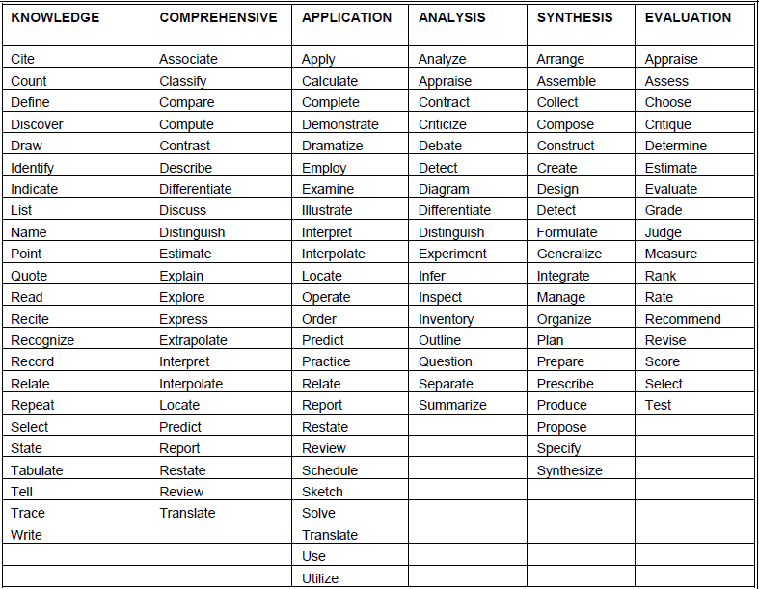
Desired State
Bloom’s Taxonomy
Notes:
Bloom’s Taxonomy may be used to help write the desired state. This may also be written as an outcome statement if specific, measureable elements are added. For example: As a result of attending this session there will be a 10% increase in awareness of Quality Improvement as noted by the annual QI survey.

Slide 21
Key element
Content & Learning Strategies
Content
Provide an overview of content to be presented
A narrative format is recommended
Learning Strategies
Indicate all applicable learning strategies to be used in your presentation. (Examples: Audiovisual, Lecture, Panel, etc.)
Notes:
This part of the abstract will take the place of the planning table that was required in previous years.

Slide 22
Key element
References
Include a list of evidence-based references and/or resources used for developing this educational activity.
The references must be relevant, accurate, and reflect evidence-based practices (within the last 5 years). One exception to the use of current evidence is the use of seminal work.

Slide 23
Successful Abstract Writing
Before Submitting
Have a co-worker read and edit the abstract
Spell check and re-read the abstract
Keep copies of all communication
Notes:
Prior to submitting an abstract, have peers review and provide recommendations. Remember to re-read the submission carefully, spell check does not always pick up on errors or may change the spelling of the word. Keep all submission documents and communication documents either electronically or in a file for future reference. If the abstract submission is electronic, obtain the submission format and type all the necessary information into a Word document. Then copy and paste the information into the electronic submission format and double check before hitting “submit.”

Slide 24
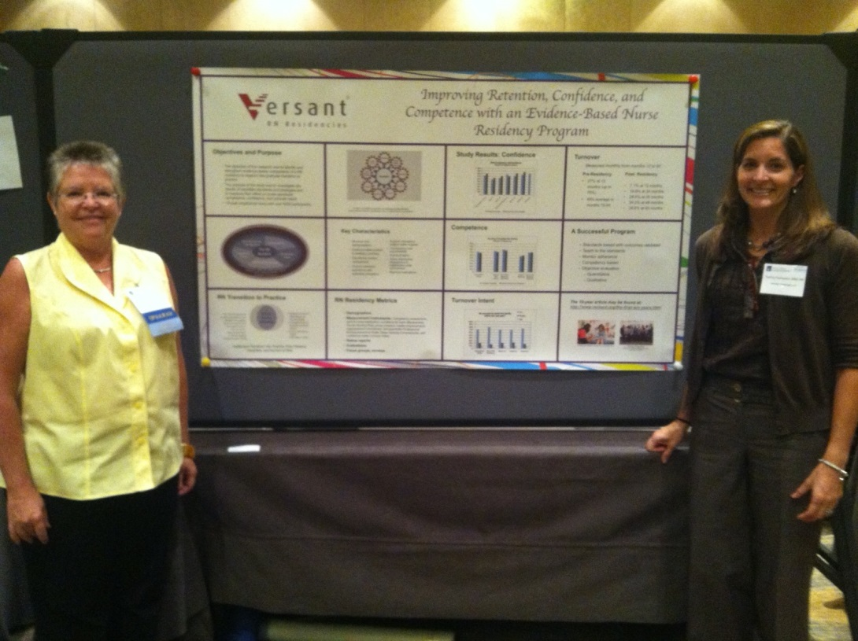
Successful Abstract Writing
Copyright & Original Work
Abide by Copyright laws
Generate original work
Notes:
U.S. copyright law (title 17 of the U.S. Code) provides for copyright protection of literary and artistic works. Copyright protection begins automatically when a work is first created in a fixed form. Work protected by copyright includes written and electronic documents, visual depictions and graphics, cartoons and comic strips. In addition, make sure your submission is in your own words. Many conferences verify the originality of suspect work through plagiarism detection software.
Original work: Unlike journal articles, most conferences allow submission of work that has been previously presented. Check the call for abstracts closely to see if the conference requires original work.

Slide 25
Successful Abstract Writing
Common Mistakes
Spelling and grammatical errors
No clear link to the conference theme
Aims, objectives, and content are not in alignment
Too much material is presented
No new information is presented
Implications for participants and/or the profession are not addressed
Notes:
As you review the abstract watch out for the most common mistakes. Be sure the topic is clearly linked to the conference. Some abstracts are too generic and may appear the abstract was written for multiple submissions without tailoring it to the unique interests of the conference theme and participants.
Reviewers have to be able to see that the amount of material covered in the abstract will fit the allotted time for a presentation or be able to be addressed as a poster.
(Saver, C. 2011)
Continued on next slide

Slide 26
The selection process
  Most conferences use a double-blind process to review and accept abstracts.
  A scoring process is usually used.
Notes:
Abstracts are reviewed by content experts. It is usually done “blind”—they do not know the name or organization of the presenter. Some type of scoring metric is usually used. Those with the most points go for further review.

Slide 27
Bio & Coi
Biographical Data (BIO) & Conflict of Interest (COI)
Names, titles, and expertise of presenters
Conflict of interest disclosure statements from presenters
Notes:
Expertise: Provide a brief summary of your qualifications to present the topic. For example:
Mary Jones is presenting on Quality Improvement. Her BIO form notes:
Mary Jones MSN RN-BC, Versant Manager, has been in this role for 5 years. Is key in implementing and educating staff regarding Quality Improvement initiatives. Has developed and presented multiple internal and national presentations on this topic. Board certified in professional development. Our organization is an ANCC accredited Provider Unit.
ANCC defines COI as “an affiliation or relationship of a financial nature with a Commercial Interest Organization (any entity producing, marketing, reselling or distributing healthcare goods or services consumed by or used on patients…) that might bias a person’s ability to objectively participate in the planning, implementation, or review of a learning activity.”
A BIO-COI form will be requested if accepted.
If you are not sure whether you have a COI or not contact us at VersantPU@versant.org

Slide 28
Once accepted…

Slide 29
Curriculum Vitae or Resume
Poster
Hall, S. (2013, November). The Match Game: An innovative approach to behavioral-based preceptor matching and training. Poster presented at the annual Versant Client Conference.
Notes:
Once your presentation has been accepted, you may add this accomplishment to your resume/CV. The above is an example, using APA 6th edition, of how to cite a poster presentation on your resume/CV.

Slide 30
Curriculum Vitae or Resume
Paper
Willsey, D., Root, S. & Smith, D. (2013, November). Transforming the perioperative setting through the RN residency and Periop 101. Paper presented at the annual Versant Client Conference.
Notes:
For a paper, substitute paper title for poster title, italicized; use the word paper instead of poster

Slide 31
Curriculum Vitae or Resume
Podium
Franqueiro, T. & Shinners, J. (2013, April). New graduate perception of preceptors: Characteristics of success from a national data set. Podium presentation at the annual American Academy for Preceptor Advancement, Miami, FL.
Notes:
The above is an example, using APA 6th edition, of how to cite a podium presentation on your resume/CV.

Slide 32
Presentations to Articles
Consider using your abstract as an outline for a journal article.

Slide 33
References & Resources
Harper, M., & Maloney, P. (Eds.) (2016). Nursing professional development: Scope and standards of practice. (3rd ed.). Chicago, IL: Association for Nursing Professional Development.
Dickerson, P. S. (2012). What is a gap and how do I fill it? The Journal of Continuing Education in Nursing, 43(3), 100-101.
Heinrich, K T. (2012). Four steps to preparing irresistible presentations. American Nurse Today 7(3) 22-24
Saver, C. (2011). Anatomy of writing for publications for nurses. Indianapolis, IN: Sigma Theta Tau International.
Notes:
American Nurses Credentialing Center. (2008). Approved verb list. Retrieved from: http://www.ndna.org/Approved%20Verb%20List.pdf
Breitenbach, A. (2011). Making a concrete abstract. APA Style Blog. Retrieved from: http://blog.apastyle.org/apastyle/publication-process/
Dickerson, P. S. (2012). What is a gap and how do I fill it? The Journal of Continuing Education in Nursing, 43(3), 100-101.
Education Resources Information Center [ERIC]. (n.d.). Structured abstract initiative. Retrieved from: http://www.eric.ed.gov/ERICWebPortal/resources/html/about/sa_initiative.html
Harper, M., & Maloney, P. (Eds.) (2016). Nursing professional development: Scope and standards of practice. (3rd ed.). Chicago, IL: Association for Nursing Professional Development.
Institute of Medicine. (2010). The Future of Nursing: Leading Change, Advancing Health. Retrieved from: http://books.nap.edu/openbook.php?record_id=12956
The Writing Center at UNC Chapel Hill. (2012). Abstracts. Retrieved from: http://writingcenter.unc.edu/handouts/abstracts/

