Slide 1
GUIDELINES FOR SUBMISSIONS

Slide 2
Table of Contents
Submission Deadlines…………………………………………..…… Slide 3
Portal Information for Submitters………………….….………. Slide 4
Things to Know Before You Submit……………….….………. Slide 5
Designating the Level of your Presentation……….……… Slide 7
Master Clinician Sessions……………………………….…............ Slide 8
Symposia…………………………………………………………...…........ Slide 10
Workshops………………………………………………….….….………. Slide 12
Roundtables……………………………………………………...……….. Slide 14
Review Criteria for Group Submissions………......…........... Slide 15
Learning Objectives………………………………………………..….. Slide 16
New Research Posters…………………………………….....…...….. Slide 17
Review Criteria for New Research Posters………............… Slide 20
Donald F. Klein Award……………………………………….………... Slide 22
Career Development Leadership Program.………………… Slide 23

Slide 3
Submission Deadlines
Wednesday, September 1, 2021: Master Clinician Sessions
Acceptance Notifications : No Later Than October 2021
Wednesday, September 22, 2021: Symposia, Workshops, Roundtables
Acceptance Notifications: Early November 2021
Wednesday, October 6, 2021: Awards: Donald F. Klein Early Career Investigator Award and Career Development Leadership Program Applications
Acceptance Notifications: Early November 2021
Wednesday, October 27, 2021: Posters
Acceptance Notifications: Early November 2021

Slide 4
Portal Information for Submitters
ADAA uses CadmiumCD as our submissions platform. The first time you visit the system, you’ll click “Join Now” to create a username and access key. Please make a note of this information as you will need it for subsequent log ins.
Submissions can be saved and submitted at any time before the appropriate deadline (refer to slide 3 of the PowerPoint). In order for your submission to be considered complete, you must click on the “Submit” button. Note: once a submission has been submitted you may not make additional changes.
Please be mindful of spelling, capitalization, and grammar. ADAA will not proofread submissions prior to peer-review. A poorly written submission may impact a reviewer’s impression.
Communication about the 2022 conference is exclusively by email; please add @adaa.org to your safe-sender list.
Questions? Email conference@adaa.org
For more information about the 2022 ADAA Conference visit:
https://adaa.org/conference

Slide 5
Things To Know Before You Submit
All session and poster presenters must register at the appropriate registration fee to attend the conference. Session chairs/organizers are responsible for making sure that all presenters agree to this requirement. ADAA is unable to provide a discount for presenters.
The 2022 conference is scheduled for March 17-20, 2022. By submitting, you agree to present on any of those days. ADAA is unable to take scheduling requests.
Submissions can be saved and submitted at any time before the appropriate deadline. You must click on the submit button for your submission to be complete. Once submitted, you will not be able to go back and make additional changes.
Presenters may submit up to four presentations, but only two may be accepted. (Excludes chairs, discussants, and poster presentations.)
Session submitters/chairs are responsible for ensuring the submission is completed by the deadline- this includes individual abstracts for symposia.
Begin the submission process early to allow time to edit/add information. Save your submission and log back in to finalize by the deadline. Avoid waiting until the final days – if you have any questions or need assistance, the conference team may be delayed due to a high volume of emails at that time.
All session descriptions and individual symposium abstracts are peer-reviewed for scientific and educational merit. Be sure to provide enough content for reviewers to evaluate your submission.
Be clear about results, educational need, and contribution to advance science or practice. DO NOT write, “…has been presented before with good reviews” or “results will be discussed.”

Slide 6
Things to Know Before You Submit
Write learning objectives using action verbs (see slide 16).
DO NOT enter test or multiple submissions for the same presentation. You can log in more than once up to the deadline to complete an abstract.
Abstracts should not include charts, graphs, or references.
Do not include a department name in the author/presenter affiliation.
You must designate the level of the presentation: Read guidelines on slide 7.
Be sure to read “Review Criteria” on slide 15.
Submission site closes at 11:59 pm (ET) on the stated deadline. Incomplete or late submissions will not be sent for peer review.
In line with the theme of the 2022 Annual Conference : Common Psychopathology: What Can the Past Tell Us About the Future, ADAA encourages submissions focused on new treatments, hot topics, and common pathology across depression, trauma, and anxiety disorders. Examples include:
Preventative interventions improving symptoms across disorders
Treatments showing efficacy across disorders
Studies investigating mechanisms of action of therapies with known efficacy in multiple disorders
Studies showing common pathology across disorders (e.g., gray matter deficits in depression, trauma, and anxiety disorders)
Presentations discussing the challenges of the past that hindered the development of biomarkers or biologically based diagnoses
Hot topics in mental health (e.g., topics related to the COVID-19 pandemic, racism, disparities, psychedelics, etc.)

Slide 7
Designating the Level of your Presentation
You must designate the level of the presentation. Read guidelines below:
Introductory: Sessions for those who have not had training in the topic; appropriate for those in training and those interested in learning new skills. They can feature general overviews of conditions and research studies that do not require in-depth knowledge of the topic, as well as introductions to treatment planning and strategies.
Examples: “Introduction to Exposure Therapy for OCD,” “Pharmacotherapy for Treatment-Resistant Depression,” and “Use of Complementary and Alternative Medicine.”
Intermediate: Sessions requiring a moderate understanding of a condition, experience with treatment strategies, or knowledge of related topics, including research studies. They provide little background information and focus on specific principles. Abstracts should include up to three concepts familiar to attendees, such as exposure and response prevention, reassurance seeking, or hierarchy.
Examples: “Incorporation of Specific Protocols to Treat Reassurance Seeking Behavior in OCD,” and “Enhancing Engagement in Exposure-Based Treatment for PTSD.”
Advanced: Sessions requiring an advanced understanding of a condition, experience with treatment strategies, or knowledge of related topics, including research studies. They provide no background information and focus on specific and advanced principles. Abstracts should include up to three concepts familiar to attendees, such as exposure and response prevention, reassurance seeking, or hierarchy.
Examples: “Solving Problems in the Therapeutic Relationship,” “What Works and How: Primary Outcomes and Mechanisms of PTSD Treatment in Veterans from the PROGRESS Trial”
NOTE: ADAA Conference Attendees have expressed a desire for more advanced sessions. Priority will be given to submissions targeting this level of presentation.

Slide 8
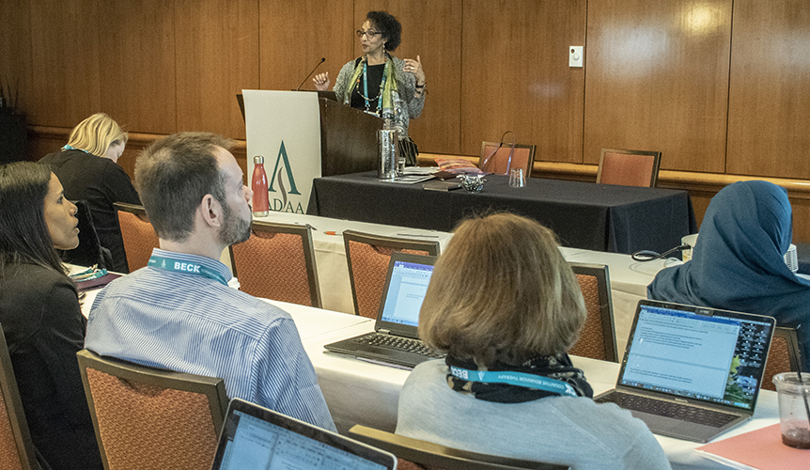
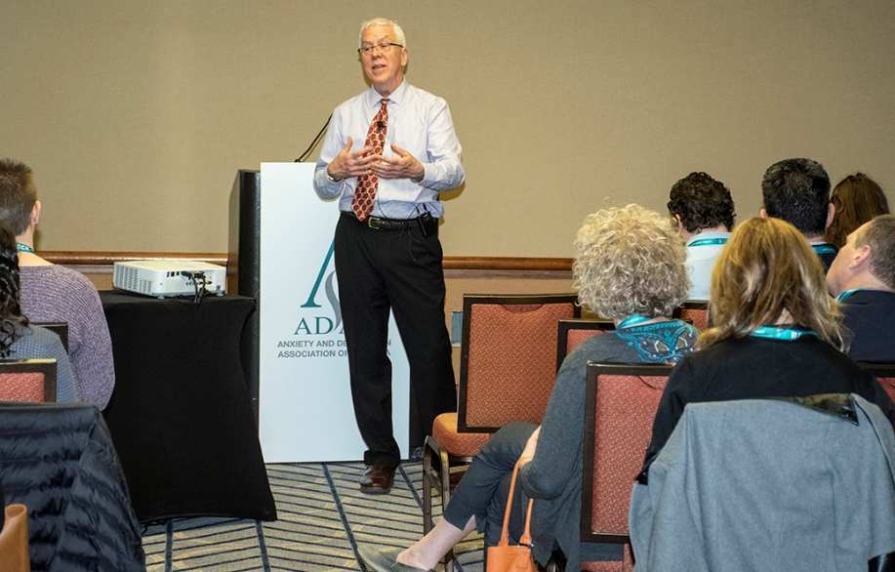
Master Clinician Sessions
Deadline: Wednesday, September 1, 2021
Interactive, experiential, in-depth training, and skills acquisition
Target experienced clinicians (MD, MFT, MSW, PhD, PsyD, etc.)
90 minutes
Submit title, abstract (3000 characters maximum) , three learning objectives.
For intermediate and advanced sessions, describe what attendees should know to make the most of the session.

Slide 9
Sample Outline: Master Clinician
Audience level: Advanced; expect participants to be familiar with DSM-5 criteria for disorder and have experience treating patients with comorbid anxiety and mood disorders.
Format: Lecture, interactive role-playing, and discussion. Use video clips to demonstrate techniques with different patients.
Overview:
Survey participants for their “burning questions.” (15 min.)
Give overview of theoretical framework and research. (15 min.)
Show techniques taught using video clips of cases that clearly demonstrate how to implement this psychotherapeutic approach. (30 min)
Role-play using case examples generated by audience. You can also bring cases to discuss. (30 min.)
Follow-up discussion about barriers to implementation and answer questions. (20 min.)
Wrap up with how to learn more. (10 min.)
State past experience, such as: “I have offered versions of this session at national meetings for the XYZ Association, Society of ABC, and regional meetings in the Southwest over the past five years. I am board certified in sleep and behavioral medicine.”

Slide 10
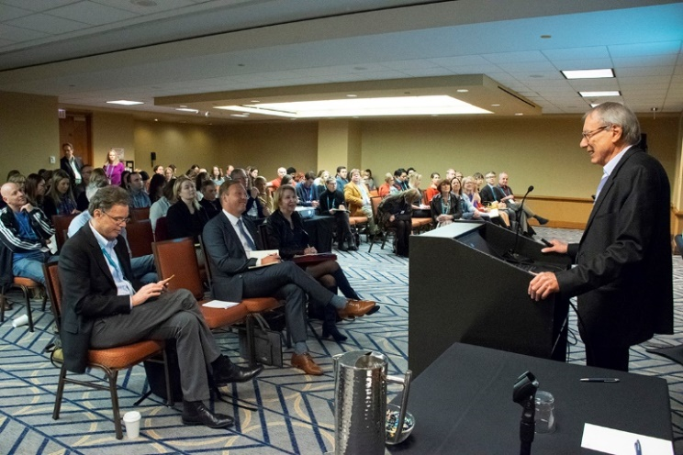
Symposia
Deadline: Wednesday, September 22, 2021
Group presentation organized around a specific theme
Up to 4 presenters, plus chair/co-chair, and one optional discussant
90 minutes
Submit session title, abstract (3000 characters maximum) , three learning objectives
Submitter adds session details and additional presenter information (name, degree, institution, email). Once presenters are added, submitter may invite them to complete additional required information.
Individual presentation abstracts must be submitted for peer review.
Session submitter is responsible for ensuring all presentations are added and disclosures are completed for finalizing overall submission.
Note: ADAA will accept 30 Symposia presentations for the 2022 Conference.

Slide 11
Sample Abstract: Symposia
Sample Session Abstract: The current symposium will be the first presentation of the primary outcomes and mechanisms results from the largest (N = 223) PTSD treatment and integrated mechanisms trial conducted to date: The Prolonged Exposure and Sertraline Trial (Progress). This randomized controlled trial (RCT) focused on a key question in clinical management of posttraumatic stress disorder (PTSD) - the comparative and combined effectiveness of medication and psychotherapy. Increased emphasis on mechanisms of treatment effectiveness, biomarker predictors, and objective indicators of treatment response has sparked interest in integrated, translational treatment outcomes trials. Progress employed a state of the art trial design to examine psychotherapy and medication effects across three conditions: 1) Prolonged Exposure (PE) plus pill placebo, 2) Sertraline (SERT) plus Enhanced Medication Management (EMM), and 3) Combined treatment (PE/SERT). Innovative measures captured potential biomarker predictors and indicators of treatment response within and across these three treatment conditions in Operation Enduring Freedom/Operation Iraqi Freedom/Operation New Dawn (OEF/OIF/OND) service members and veterans with PTSD. Assessments included clinician-rated measures, self-report outcome measures, saliva for salivary cortisol and cortisol response to awakening at six assessment points, blood at baseline and week 24 for genetic and genomic analysis, as well as resting state connectivity and emotion processing and regulation using functional Magnetic Resonance Imaging (fMRI) paradigms in a subsample of veterans. Accordingly, the results provide pragmatic clinical direction for the delivery of PTSD treatment through its primary outcomes in an effectiveness design, and informative results to elucidate underlying mechanisms and biomarkers involved in PTSD treatment response.
Sample Individual Abstract: Background: Resting-state functional connectivity (rsFC) magnetic resonance imaging (MRI) represents a powerful method for illuminating brain network function. Moreover, abnormalities in rsFC have been recently demonstrated in posttraumatic stress disorder (PTSD), suggesting they may have particular relevance for this condition. The current study examined pre to post treatment changes in rsFC in PTSD during the randomized treatment trial (PROGrESS; Rauch et al., 2018). Methods: Sixty-four combat veterans with PTSD were randomly assigned to three treatment groups: Prolonged Exposure plus placebo (PE +PLB), sertraline plus enhanced medication management (SERT + EMM), or PE+SERT. Twenty-nine combat veterans without PTSD were recruited as a control group. Symptom assessment and resting-state MRI scanning occurred before and after treatment. Seed-based and connectome-based approaches were used to analyze rsFC. Results: Before treatment, PTSD was associated with less connectivity between PCC, vmPFC and other default-mode network (DMN) regions (both p<.050; FWE corrected), replicating prior findings of decreased within-DMN connectivity in PTSD. PCC and vmPFC, as well as the insula (salience-network (SN) seed), had greater connectivity with regions within the dorsal-attention network (DAN) in patients, which is in line with the cross-network desegregation in PTSD (all p<.050; FWE corrected). Patients who had more than a 50% decrease in PTSD symptoms with treatment (i.e., “responders”) had lower pre-treatment amygdala-PCC connectivity (p=.011), suggesting the pivotal role of SN-DMN segregation in PTSD treatment. In addition, these patients had lower global centrality (p=.042), suggesting that topological features of the brain may also be related to PTSD treatment response. Conclusions: These findings replicate and extend our knowledge of network-level abnormalities in PTSD, and importantly, suggest potential neural biomarkers of PTSD treatment response. (* Rauch, S.A.M. and Liberzon, I. contributed equally to this work.)

Slide 12
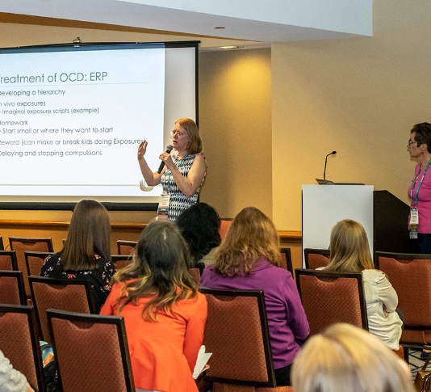
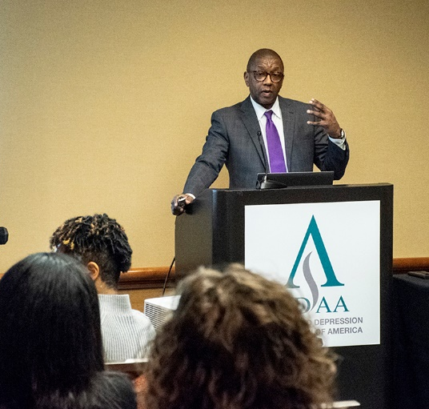
Workshops
Deadline: Wednesday, September 22, 2021
Interactive, experiential training, skills acquisition, and discussion of treatments through case presentations
60 minutes
Up to 4 presenters
Submit a title, abstract (3000 characters maximum), three learning objectives.
Sample Workshop Abstract
Some individuals do not sufficiently benefit from the evidence-based treatments currently available for anxiety disorders. One factor associated with poor treatment outcome is the presence of treatment-interfering behavior (TIB). This workshop will describe Treatment-Readiness Therapy (TRT), an approach to the modification of TIB. TRT is an integrative, modular approach that draws from a variety of research and sources, including cognitive and behavioral models and motivational interviewing principles, to address the various factors that influence TIB. This workshop will apply the principle components of TRT in the presentation of case vignettes. These vignettes will illustrate how to formulate a case. Additional case examples for adults will demonstrate how to design interventions. TRT can be applied in different practice settings and by a range of providers treating individuals with behavioral and pharmacological treatment, or a combination. Attendees are encouraged to bring examples from their practice to discuss. This workshop is for experienced clinicians from all disciplines. Students, trainees and residents are welcome and encouraged to attend to learn about cases in real-world settings.

Slide 13
Sample Outline: Workshops
Format: Lecture, presentation of case vignettes to illustrate how to formulate a case.
Overview of Workshop:
Introduce yourself.
Meet participants to understand level of familiarity and “burning questions.” Give overview of theoretical framework and research.
Show techniques taught using cases that clearly demonstrate how to implement this approach in different practice settings.
Follow-up discussion about barriers to implementation and answer questions.
Wrap up with how to learn more.
State past experience, such as: “I have presented versions of this workshop at national meetings for the XYZ Association, Society of ABC, and regional meetings in the Southwest over the past five years. I am certified in CBT.”

Slide 14
Roundtables
Deadline: September 22, 2021
Interactive discussion on a focused topic, case presentations, issue, or question in practice or research
Submit title, abstract (3000 characters maximum), including specialty area of panelists but NOT names, target audience, and three learning objectives.
60 minutes
Minimum 3; Maximum 5 panelists plus chair
Sample Roundtable Abstract
Technology-augmented interventions address many of the challenges, including availability, accessibility, and efficacy of CBT for anxiety disorders. Given recent advances in the availability and affordability of smart and mobile devices and tablet technologies, we’re seeing a paradigm shift in the delivery of evidence-based treatments. This trend will increase accessibility to clinically effective and cost-efficient care with experientially driven, user-friendly technology products combining interactive media and best practices. These technologies have the potential to dramatically change the climate for early outreach, dissemination, and implementation of EBTs targeted to needs of clinicians, patients, and their families. Four panelists will discuss research and clinical projects that target the development, evaluation, and dissemination of technology-enhanced clinical tools. Projects reviewed will include educational, assessment, and treatments solutions targeting PTSD, social anxiety disorder, and pediatric spectrum anxiety as a whole. The panelists will share successes and challenges related to their respective technologies, including live demonstration of project features. Given the panelists’ unique expertise and access to a variety of enabling technologies, they will discuss how these technologies (e.g., webcams, online videos, virtual reality) can be incorporated in the delivery of interventions for the novice or seasoned clinician. Audience members will be encouraged to ask questions, share their experiences with technology, and witness or interact firsthand with the panelists’ technologies during the presentations.

Slide 15
Review Criteria for Symposia, Workshops, Roundtables
Highly-Ranked Presentations:
Present innovative or novel approaches, techniques, or treatments.
Include researchers and clinicians on symposia and roundtables.
Address an important, highly relevant, or hot topic.
Include a topic that is a good fit with conference theme.
Provide high-value opportunities for learning and networking.
Present new data (for research sessions).
Address challenges or obstacles that arise when implementing treatments (for practice sessions).
Criteria:
Clearly written abstract and learning objectives.
Clearly described outcomes.
Description of why new skills, techniques, or approaches are important (for workshops).
Results must be included for symposia abstracts
Important Notes:
We encourage interactive presentations comprised of both clinicians and researchers and also speakers from different institutions and countries.
We encourage submissions related to the 2022 Theme – Common Psychopathology: What the Past Can Tell Us About the Future.
We strongly encourage submissions on diversity and related to cultural, racial, and socioeconomic barriers to mental health care.
New first-time presentations will be given priority
If a presentation has been made previously at ADAA, presenter needs to provide a rationale for why it should be repeated.

Slide 16
Learning Objectives
Examples
Focus on the attendee and describe what he or she will learn, know, or be able to do as a result of your session.
Use action verbs that describe measurable behaviors: analyze, apply, assess, create, compare, demonstrate, describe, discuss, explain, plan, practice, predict, recognize, summarize, use, etc.
Do not use these words: learn, know, understand, appreciate.
Do not write “participants will learn how to treat anxiety” or “participants will understand how to motivate patients to exposure therapy.”
At the end of this session, participants will be able to…
Recognize differences between acute and traumatic stress.
Apply novel pharmacotherapies when treating patients with comorbid anxiety and depression.
Practice relaxation and breathing techniques.
Summarize genetic advances in our understanding of related disorders.

Slide 17
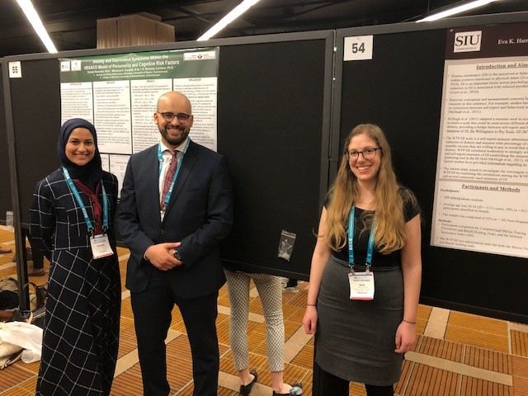
Posters
Deadline: Wednesday, October 27, 2021
Individual presentation in a poster format shares new research findings or unique clinical treatment techniques.
Abstracts must include a title and 3000-character abstract; no learning objectives.
Posters based on original studies that lack meaningful data (include N) will be rejected.
Presenters must attend poster session.
Presenters of accepted posters must register and pay the fee or their poster will be removed from the program.
Poster presenters must upload PDF for e-Poster site if accepted.

Slide 18
Sample Abstract: Posters (slide 1 of 2)
Background: Despite being at disproportionately higher risk for trauma exposure and trauma-related psychological problems such as alcohol or substance abuse, the majority of low-income African Americans do not develop alcohol or substance use disorders. According to the “Broaden and Build Model,” individual factors, such as the presence of optimism or positive emotional traits such as joy and contentment, may explain this resiliency (Fredrickson, 2004). However, research in this area needs to be expanded to account for the impact of cultural and familial factors such as types of social support provided (family and/or community) and parental substance abuse history.
Methods: As part of a larger NIMH-funded study, we gathered data from 991 African American adults, ages 18 to 65, recruited from an urban public hospital. We assessed substance abuse, trauma exposure, and social and emotional support via the following self-report measures: the Traumatic Events Inventory (TEI), which was used to assess lifetime trauma exposure; the Clinical Data Form (CDF), which assesses support an individual receives from their parents or guardians as a child; the Child Community Support Questionnaire (CCSQ), which assesses support an individual receives as a child from adult outside of their parents or guardians; and the lifetime Alcohol Use Disorders Identification Test (AUDIT), which assesses problematic alcohol use patterns.
Continued on next slide>>>

Slide 19
Sample Abstract: Posters (slide 2 of 2)
Results: A hierarchical regression indicated that, after controlling for age and trauma exposure, community support (CCSQ adult support: β=-.06), family stability (CDF family: β=.2), and parental alcohol/substance abuse (CDF parent drug/alcohol use: β=.13) significantly predicted problematic drinking behaviors in the lifetime (AUDIT lifetime total score; R2 =.21, p<.001). Conclusion: Findings extend prior research on the “Broaden and Build Model” regarding the protective effects of social and emotional support; these data may help increase our present understanding of resilience in high-risk, low-income African American adults. Findings underscore the role of social support, family stability, and parental alcohol/substance abuse on problematic alcohol use in this population. These data have implications for the development of culturally competent models of prevention and treatment of alcohol and substance abuse.

Slide 20
Review Criteria: Posters
Presents preliminary analyses using a sample size sufficient to generate statistically significant, meaningful, and generalizable findings.
Presents new techniques/ideas.
Addresses an important, highly relevant, or hot topic.
Advances research, treatment, or understanding of anxiety, mood and/or related disorders.
Demonstrates high scientific and intellectual quality.

Slide 21
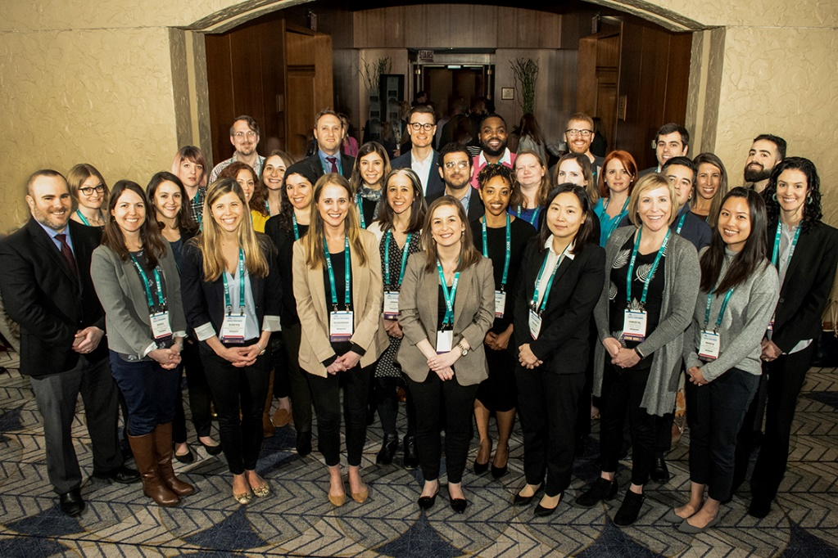
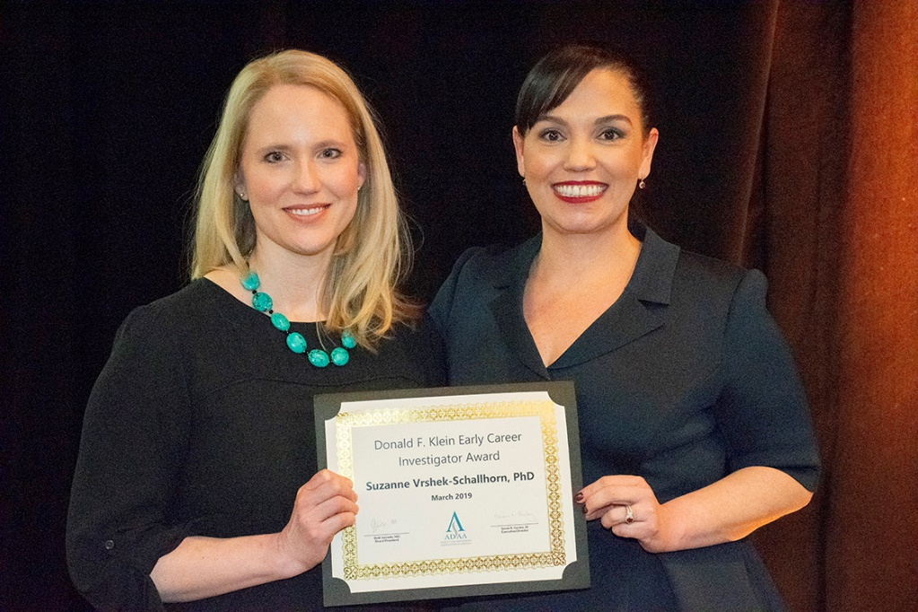
ADAA 2022 Award Programs

Slide 22
Donald F. Klein Early Career Investigator Award
Award Components
Complimentary registration to the 2022 ADAA Annual Conference ($600 value)
Recognition at the Opening Session
Complimentary one-year ADAA membership. Awardee(s) must present their research as a poster at the Annual Conference to be eligible for the complimentary membership
$500 award
Selected paper will be seriously considered for publication with formal review in ADAA’s journal - Depression and Anxiety
Featured profile on the ADAA website
Opportunity to present research findings as an ADAA-sponsored webinar
Award Eligibility
The award is restricted to investigators who have completed their terminal degree and are currently at a rank of assistant professor or below.
Individuals who are working to complete their degree are not eligible.
Applicants must be the first or senior author on the submitted paper, which must be original research on anxiety disorders, depression, and comorbid related disorders, focusing on neurobiology, psychosocial treatments, or experimental psychopathology.
The paper cannot be submitted or under review anywhere else from submission until notification about the award (including ADAA's Depression and Anxiety Journal).
ADAA Board Members and the ADAA Scientific Council members are not eligible.
ADAA recognizes, supports, and values the inclusion of diverse groups, educational backgrounds, and views and encourages award applications from minority groups. ADAA also encourages interdisciplinary as well as international applicants.
Application Deadline: Wednesday, October 6, 2021

Slide 23
Career Development Leadership Program
Award Components
Complimentary registration to the 2022 ADAA Annual Conference ($600 value)
A full day of small-group mentoring sessions
Complimentary one-year ADAA membership. Research track awardee(s) must present their research as a poster at the Annual Conference to be eligible for the complimentary membership
Assignment of a senior mentor from the ADAA professional membership at the conference
Recognition at the conference
Basic Neuroscience and Clinical Research Tracks: Presentation of a poster at the poster session at the conference is mandatory
Clinical Track: Case consultation session with a senior clinician from the ADAA membership
Featured profile on the ADAA website
Award Eligibility
Participants are required to attend all scheduled program events and attend the conference. After receiving one-year complimentary membership, become an active leader within ADAA, including but not limited to joining a Special Interest Group, starting a Special Interest Group, developing a webinar, authoring a blog post, or serving on a committee
Program open to graduate degree students (MD, MPH, MS/MSW, NP, PhD, PsyD) intern, resident, or postdoctoral fellow
Early career researchers and clinicians who have completed their training within the last give years. The program welcomes applications from: Masters in Counseling, Masters in Social Work, Marriage and Family Therapists, Trainees/Graduates in Clinical Psychology, Counseling Psychologies, School Psychologies, Neuropsychologists.
ADAA recognizes, supports, and values the inclusion of diverse groups, educational backgrounds, and views and encourages award applications from minority groups. ADAA also encourages interdisciplinary as well as international applicants.
Application Deadline: Wednesday, October 6, 2021

