Slide 1
AMCHP 2027 Annual Conference:
Call for Proposals Webinar
Caroline Stampfel, AMCHP
Rachel Borgie, CM Event Solutions
August 27, 2026

Slide 2
What’s our Why?
Visibility: Highlights impact MCH programs are making at the national, state, and local levels for women, children and families
Resources: Provides participants with methods, tools and resources to develop, enhance and sustain vital MCH programs and services
Networking: 1,000+ attendees annually; one of the largest gatherings of MCH leaders in the country
Impact on MCH: In a post-conference evaluation, 87% of respondents reported having applied one or more of the concepts, skills, or tools obtained at the conference to their work

Slide 3
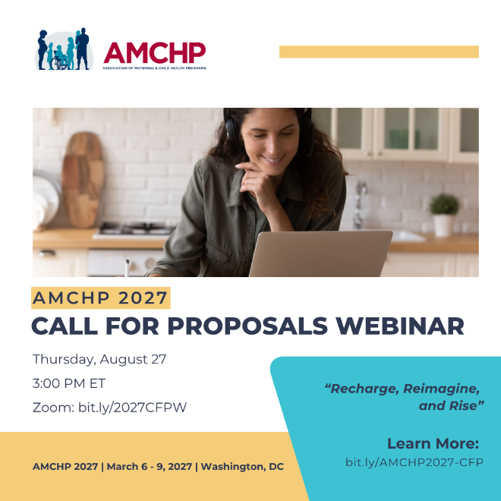
Agenda
Review the Conference Theme
Key Dates
Call for Proposals Elements
  Overview of the Session Types
  The body of the proposal
  Presenter Information
  Video Submissions
Review Criteria
Q&A

Slide 4
AMCHP 2027 Annual Conference Theme:
Recharge, Reimagine, and Rise

Slide 5
Recharge, Reimagine and Rise
AMCHP 2027 will be a place for us to recharge, reimagine, and rise together. In a time of profound transition, we gather to rejuvenate and renew our commitment to children, families, communities, and one another—creating space for healing, meaningful interactions, and the kind of generativity that sustains us through challenging times.
Together, we will ask: What's empowering and fulfilling us through turmoil? What's keeping us here? Together, we can reimagine our relationships, catalyze innovation, and build momentum for action in response to emerging issues and new possibilities. Making change is hard, but change is coming. In fact, change is here. By imagining what is possible and rising to meet this moment, we can shape a more responsive and resilient future for maternal and child health.

Slide 6

Key Dates
Call for proposals Opens: August 3, 2026
Call for Proposals Closes: September 30, 2026
Registration opens: October 1, 2026
Proposal Reviews Due: October 7-24, 2026
Acceptance Notices go out: November 19, 2026
Early Bird Registration Closes: January 16, 2027
Conference Dates: March 6-9, 2027

Slide 7
Venue / Presentation Modes
We will be in-person only in Washington, DC
Venue: The Westin Washington DC Downtown
999 9th St NW, Washington, DC 20001
Workshops, grand rounds, lightning talks, discussion sessions

Slide 8
Overview of Session Types

Slide 9
Call for Proposals – Session Types
Workshops: 60 minutes in length
Workshops, which are shorter than skills-building sessions, are conference breakout sessions designed for interactive exploration of a topic, rather than extended, hands-on skill training. Workshop proposals are submitted through the conference call-for-proposals process. Rather than a series of short presentations, workshops focus on engagement through facilitated discussion, exercises, demonstrations, case studies, problem-solving activities, or guided collaboration, with 45 minutes allotted for presentation content. Sessions may feature a single facilitator or multiple presenters who bring complementary expertise and perspectives. Workshops are structured to encourage active audience participation and meaningful knowledge exchange. To foster dialogue and address attendee interests, workshops must include at least 15 minutes dedicated to Questions & Answers (Q&A) and discussion with participants.

Slide 10
Call for Proposals – Session Types
Student and Early Career Professional Grand Rounds:10 minutes in length; Session: 1 hour total
Student / Early Career Grand Rounds provide a unique opportunity for students and early career professionals to share their work, ideas, questions, and emerging areas of interest with experienced Maternal and Child Health (MCH) professionals from across the country. This format is designed to promote mentorship, professional development, and collaborative learning. Each presenter will deliver a 10-minute presentation that may highlight a project, research topic, practice challenge, innovative idea, or area in which they are seeking feedback, guidance, or resources, for a total of 40 minutes of presentations. Following the final presentation, attendees will participate in 15-minute facilitated table-based discussions, creating opportunities for presenters and participants to engage in deeper conversation, exchange perspectives, and explore solutions and next steps. This interactive format encourages meaningful dialogue and creates a supportive environment for learning, mentorship, and collaboration across career stages.

Slide 11
Call for Proposals – Session Types
Lightning Talks: 10 minutes in length
A Lightning Talk is a short, focused presentation designed to share a key idea, lesson learned, innovation, case study, or practical insight in a concise and engaging format. Each speaker is allotted 10 minutes to present, encouraging clear, high-impact content that highlights the most important takeaways without extensive detail. Speakers are strongly encouraged to have no more than 8 slides. Each speaker will have a chance to respond to a few questions from the audience. Lightning Talks are organized into one-hour session blocks featuring no more than 5 presenters. A presentation may have 1 or 2 speakers, but the time allotted for the presentation is still 10 minutes.

Slide 12
Call for Proposals – Session Types
Discussion Topics: 60 minutes in length
Discussion Sessions are designed to foster peer-to-peer learning, knowledge sharing, and meaningful dialogue on topics of interest and importance to attendees. Unlike presentation-focused sessions, Discussion Sessions emphasize participant engagement through facilitated conversation, exchange of experiences, and exploration of challenges, opportunities, and emerging issues. These sessions are led by a designated discussion host who guides the conversation, poses thought-provoking questions, and creates an inclusive environment that encourages active participation from attendees. Proposals should identify the discussion topic, provide sample discussion questions, describe the facilitator’s experience leading group discussions or interactive sessions, and name any planned discussion co-hosts. Discussion Sessions will be offered during the conference’s concurrent breakout session times. Sessions may be scheduled for up to 60 minutes and are expected to prioritize attendee interaction and dialogue over formal presentations.

Slide 13
The body of the proposal:
How will you describe your work?
AMCHP uses “your work” to include: a practice, program, project, topic, analysis, or initiative.

Slide 14
Proposal Body: Workshop, Lightning Talk, or Grand Rounds Proposal Details
AMCHP does not use the traditional scientific format for proposal submissions.
The questions represent parts of your proposal description, instead of a typical "abstract box" submission.
Please use the questions to guide your submission, and feel free to reach out to us if you have questions or need more support.
Proposal reviewers will use your responses to the questions to evaluate your session.
As you respond to the questions, imagine you are explaining your work to someone who has never heard of it before.
* indicates a required field

Slide 15
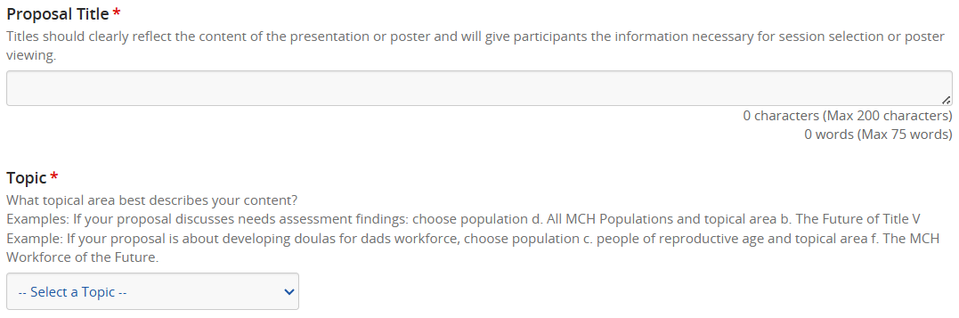

Slide 16
What topical area best describes your content?
a. Children & Youth with Special Health Care Needs (CYSHCN) & Complex Care (includes Systems of care, Care coordination, Transition to adulthood, Financing and Medicaid partnerships, Family engagement, Parity in CYSHCN outcomes, Education systems, Medical home)
b. The Future of Title V: Modernizing Administration, Accountability, & Impact (includes Data modernization for Title V, Rethinking needs assessments, Next gen performance measurement, Cross-agency alignment, Modern grant management, Digital tools for reporting and engagement, Universal Title V measures, Partnerships with Medicaid, education, and other agencies)
c. Mental and Behavioral Health Across the Lifespan (includes Perinatal mental health, Child/adolescent mental health, Substance use, Trauma-informed systems, Integrated behavioral health)
d. Epidemiology, Technology, & Evidence for the Future of MCH (includes Data-to-action strategies, Addressing data gaps, Community-defined evidence, AI and predictive analytics, Data modernization, Real-time and passive surveillance, Digital tools for data availability, Evaluation)
e. Indigeneity & Health (includes programs, policies, and practices that support the health and well-being of American Indian and Alaska Native MCH populations and communities; examples include adolescent mental health, Indigenous birthwork and midwifery, AI/AN maternal mortality prevention, community-defined evidence, and food sovereignty)

Slide 17
What topical area best describes your content?
f. Policy & Impact (includes, but is not limited to, little p and Big P policy development, analysis, strategy, engagement, coalition building/partnerships, advocacy, implementation, best practices, lessons learned)
g. The MCH Workforce of the Future (includes Innovative leadership models, Workforce well-being, Skills and competencies, Interdisciplinary teams, Training and education models, Recruitment & Retention, Change management)
h. Creating Conditions for Healthy Communities (includes Housing + Food systems, Transportation + built environment, Economic opportunity + family wellbeing, Cross-sector partnerships, Education and early childhood supports, Public policy and systems change, Governmental public health leadership, Community-driven solutions)
i. Family, Youth, & Community Engagement Across the Life Course (includes Family partnership from preconception through adolescence, Youth voice, leadership, and governance, Community‑driven approaches across developmental stages, Culturally responsive engagement, Intergenerational collaboration, Building trust and trauma‑informed engagement, Sustainable structures for shared decision‑making, Cross‑sector engagement (schools, public health, social services, Tribal nations, community orgs)).

Slide 18
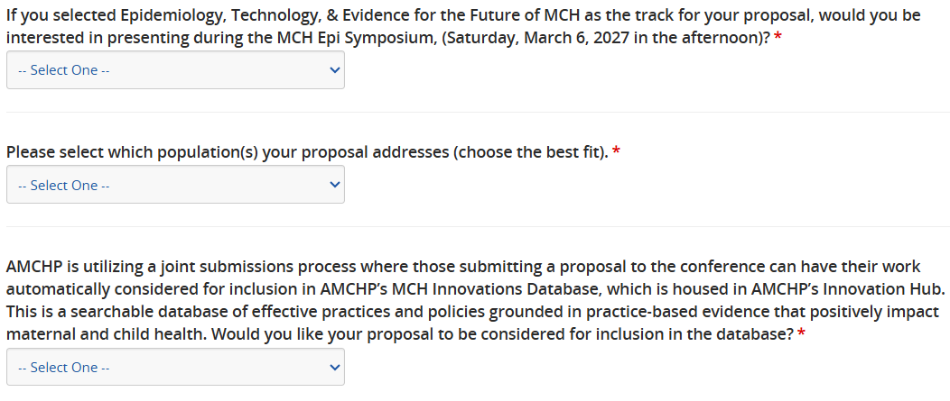

Slide 19
Populations with Brief Descriptions
Please select which population(s) your proposal addresses (choose the best fit).*
a. Children with special health care needs (includes children with medical complexity, youth and young adults with disabilities)
b. Prenatal to Age 3 (includes Pregnancy, Infant health, Early childhood)
c. Children (includes Child health)
d. Adolescents (includes Adolescent and Young Adult health)
e. People of reproductive age (includes women/mothers, men/fathers, second parents)
f. All MCH populations (includes multiple population groups)

Slide 20
Consideration for AMCHP’s MCH Innovations Database?
AMCHP is utilizing a joint submissions process where those submitting a proposal to the conference can have their work automatically considered for inclusion in AMCHP’s MCH Innovations Database, which is housed in AMCHP’s Innovation Hub. This is a searchable database of effective practices and policies grounded in practice-based evidence that positively impact maternal and child health. Would you like your proposal to be considered for inclusion in the database?*

Slide 21
Proposal Body: Questions 1-4
Provide a brief summary of your work. Include any helpful background information such as the history behind its development, any principles or values that support it, or relevant prior research.*
In what ways have families, youth, communities, and/or local leaders been meaningfully engaged across your efforts (e.g., identifying priorities, shaping design, implementing strategies, or serving as advisors)? How does this engagement promote shared power and decision-making? Please include any individuals or organizations playing a key role in these efforts.*
How is your work addressing causes of challenges and conditions that impact your key population?*
Describe any successes of your work. What is different because of the work you are going to present?*

Slide 22
Proposal Body: Questions 5-6
What important lessons have you learned (both positive and negative) through implementing your work that you can share with others who may wish to do something similar or replicate your work in a different context?*Please provide a short description for the online agenda. This description will be published in AMCHP conference materials, including the event app and website.*
Does your proposal relate to the 2027 conference theme: Recharge, Reimagine, and Rise? *
If yes, please explain how your proposal relates to the theme, including which word best characterizes how your proposal aligns (i.e. recharge, reimagine, or rise).
If no, please tell us how your proposal advances the practice of maternal and child health.

Slide 23
To guide your submission, we have included descriptions of each term:
Recharge: Dedicated to rejuvenation and sustainability, these sessions will provide space for healing, reflection, and mutual support to nourish the well-being of the maternal and child health workforce. Attendees will focus on restoring personal energy, connection, and partnership to prevent burnout during times of transition and turmoil.
Reimagine: Focused on innovation and bold visioning, these experiences challenge traditional approaches to inspire creative problem-solving and new ways of partnering. Attendees will explore emerging opportunities, spark fresh ideas, and redefine what is possible for families and communities.
Rise: Geared toward collective action and momentum, these sessions will equip leaders to meet current challenges head-on with resilience and purpose. Attendees will gain practical tools and strategies to drive systems-level change, transform insight into impact, and shape a more responsive future.

Slide 24
Proposal Body: Question 7
7. Please provide a short description for the online agenda. This description will be published in AMCHP conference materials, including the event app and website.*
This is the description that participants will see and use to make decisions about what sessions to attend – max 900 characters.

Slide 25
Discussion Session Proposal Process

Slide 26
Discussion Topic Submissions
Proposal title
What is the topic / title for your discussion?
Please provide a brief background for this topic, including why it is important for this topic to be discussed at the AMCHP conference.
What are the questions you would pose to the group for discussion?
What experience do you have with facilitation?
How would you describe your openness to various viewpoints/curiosity to learn about the topic yourself?
What, if any, assistance do you need from AMCHP staff in facilitating this discussion?

Slide 27
Discussion Topic Submissions – added this year
Please name any planned co-hosts / co-facilitators (please also include as proposal presenters in the next section).
Most sessions do not have an attendee cap, with the audience being limited only by the room size. Do you have any audience size concerns or considerations?
Please provide a short description for the online agenda. This description will be published in AMCHP conference materials, including the event app and website.
All questions are listed as required.

Slide 28
Proposal Presenters
Who will present the session?

Slide 29
Entering Submitter / Presenter Information
Please list the presenter(s) for this proposal, your proposal can have up to 3 presenters and 1 moderator. Select Save Presenters if you are done adding/updating Presenter information.
NOTE: for Lightning Talks, if there is more than one speaker, they still need to stay within the 10-minute presentation window.

Slide 30
Proposal Presenters: Roles
Presenter Role:
Primary presenter – will receive ALL communication about acceptance status, will be responsible for completing the activities in the speaker portal, and will need to communicate information to the other presenters; must have at least 1
Presenter – will attend the conference and speak during the session; Max 3
Moderator – introduces the session, helps keep the session on time, and supports audience interaction; Max 1
Presenter/Moderator – Choose this if this presenter will also serve as the session moderator; Max 1
Submitter Only – preparing and submitting the proposal only; Max 1
Co-Author – part of the work submitted but will not be presenting during the session; Max 10
Notes:
Presenter total is 4 max – 1 primary (required) and up to 3 regular speakers.

Slide 31
Presenter Profile: Required Elements
Org Type Answer Choices:
Community Based Organization
Native nation or Tribal government
State / jurisdiction government
Local government
National non-profit / non-governmental organization
Federal government
Health professional association
Academic institution
Individual (not associated with an organization)
Other
First name
Last name
Email address
Presenter role
Organization (name)
Organization Type →
Student/Youth/Early Career Professional (see next slide)

Slide 32
Presenter Profile:
Student / Youth / Early Career Professional: Please select all the categories that apply to you for the purposes of this submission:*
Answer Choices (Select all that apply):
Student: I am currently in school studying something related to public health or maternal and child health
Youth / Young adult: I am currently between the ages of 13 and 25.
Early career professional: I am less than five years removed from completing a relevant graduate or undergraduate degree and/or working in my first full-time job within or related to MCH.
None of these categories describes me.

Slide 33
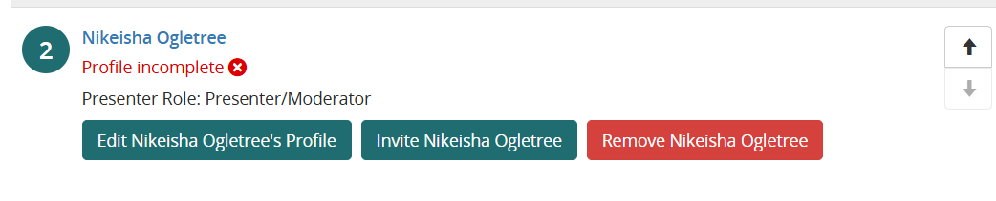
Invite proposal collaborators to complete their profile
Notes:
You can add presenters to your proposal. Once you’ve added their name, email, and role, you can invite them to complete their profile, or you can edit it for them.

Slide 34
Submitter Terms and Conditions
Submitters must agree to all terms and conditions in order to be considered:
Proposal title and short description will be used in the agenda & may be edited
All presenters must register for the conference; presenters are required to bring a laptop unless otherwise arranged
Photography / recording release
All authors know they have been included in the proposal
AMCHP’s meeting code of conduct

Slide 35
Video Submissions
AMCHP is accepting Video Submissions in place of the written submission for Workshops, Lightning Talks, and Student and Early Career Professional Grand Rounds
Submit a 5-minute video that addresses questions 1-6 of the Session Proposal Details section
  Recommend using Zoom or Teams to record yourself
  Submission format of mp4 works well
Please fill in the other questions of the proposal process (population and topic) and the presenter profile
If you are submitting a video proposal, indicate “See Video Proposal” for the required questions
If you are not submitting a video, please check the box that says “I am not submitting a video” on the next page.

Slide 36
Proposal Review
How are proposals scored?

Slide 37
Not Scored
  Population and topic area selection
  Demographic information; information about the presenters
  Session Type (workshop, lightning talk, grand rounds, discussion topic)
    We ask reviewers for feedback on whether the session type makes sense for the content of the proposal, but it is not scored

Slide 38
Review Process
Scored on a Likert-type scale from 1-5:
1=Strongly Disagree; 2=Disagree; 3=Neither disagree nor agree; 4=Agree; 5=Strongly agree
6 questions that are scored this way, for a score ranging between 6 and 30
There are three questions that elicit comments reviewers. We use these comments during the session selection process.
Rated by reviewers in a blinded fashion – this means reviewers do not see presenter information
  Reviewers are asked to recuse themselves if they are the submitter or they are involved in the work being presented
  We reassign the proposal to another reviewer

Slide 39
Completeness, Overall Impression, Potential for Impact
1. The proposal provides a thorough, complete answer to all the requested elements in the call for proposals: explains the backgrounds and context, the engagement of families, communities, and local leaders, the causes of the challenges to the key population addressed, the successes of the work, what lessons were learned, and how the proposal is or is not related to the conference theme?
[Reviewers should consider responses to questions 1-6]
2. The proposal describes what is relevant, impactful, or otherwise important about the work.
[Reviewers should consider responses to questions 3,4,5]
3. The proposal describes a session that is likely to increase awareness, build knowledge, and change the practice of conference attendees.
To score this, consider: Does the proposal describe a session that increases the awareness of a topic only, or does it seek to build knowledge on a topic? Does the proposal seek to provide information to change the way people think about a topic? Does the proposal seek to change the way programs are implemented, the way people form and sustain partnerships, or the way people engage with families, youth, and communities?
[Reviewers should consider responses to questions 1-5]

Slide 40
Centering Impacted Populations
4. This proposal describes work that meaningfully engages families, communities, and/or local leaders across their efforts (e.g., identifying priorities, shaping design, implementing strategies, or serving as advisors).
To score this, consider: Does the proposal describe engagement that promoted shared power and decision-making? Does the proposal include any individuals or organizations playing a key role in these efforts?
[Reviewers should consider responses to question 2.]
5. This proposal addresses the causes of challenges impacting the key population.
To score this, consider: Are the goals/intended outcomes reflective of the priorities, perspectives, and values of those most impacted in the key population? Do the successes described demonstrate positive impacts for members of the key population?
[Reviewers should consider responses to questions 3 & 4]

Slide 41
Conference Theme
6a. For proposals that selected they were related to the conference theme:
The proposed session clearly relates to the theme of the conference: Recharge, Reimagine, and Rise
To score this, consider: Does this proposal identify which of the three key words from the theme their proposal most closely aligns with? Does this proposal describe a session that will help participants explore how participants can reimagine relationships, catalyze innovation, and / or build momentum for action in response to emerging issues and new possibilities?
[Reviewers should consider responses to question 6]

Slide 42
Conference Theme
6b. For proposals that selected they were not related to the conference theme:
The proposed session clearly advances the practice of maternal and child health.
To score this, consider: Does this proposal describe a session that will help attendees with at least one of the following conference objectives:
• Identify practices and policies designed to grow and support impactful partnerships in maternal and child health (MCH)
• Discover methods to build authentic, intentional, impactful partnerships
• Apply impactful frameworks, theories, and approaches to MCH efforts.
• Examine ways to strengthen partnerships between families, communities, and local and state MCH programs.
• Build and apply important skills for the MCH workforce.
• Discuss emerging issues, pressing concerns, and the latest research in MCH.
• Develop new partnerships in the MCH field and beyond.
• Identify individual and organizational roles in transforming MCH systems.
[Reviewers should consider responses to question 6]

Slide 43
Feedback about Appropriate Session Type, Scoring Rationale
7. If you do not think this session should be considered for the requested session type, which session type do you recommend instead (please type only one)?
Responses: Workshop session (60 minutes) ; Lightning Talk (10 minutes); Student and Early Career Professional Grand Rounds (10 minutes); Discussion Topic session (60 minutes)
[Reviewers should consider responses to questions 1-6]

Slide 44
Feedback about Appropriate Session Type, Scoring Rationale (cont)
8. Comments: Please provide a very brief rationale for your scoring. Are there any scores above (particularly in places where you thought the submission was effective or could be improved) that you would like to elaborate on?
If you are reviewing a Student and Early Career Professional Grand Rounds submission, please provide substantive comments for the submitter, as we will provide students with this professional insight to consider when preparing accepted presentations or posters, or for future proposal submissions.
9. STUDENT AND EARLY CAREER GRAND ROUNDS ONLY: Please provide any additional comments that would support the applicant in getting the most out of the session.
Consider: How clear was the proposal description? Do they need to refine the focus, or is it too narrow? Share how well the proposal and project description were or suggest what to describe better.

Slide 45
Discussion Topic Scoring
1-Strongly disagree
2-Disagree
3-Neither disagree nor agree
4-Agree
5-Strongly agree
5 questions scored this way, for a score ranging between 5 and 25

Slide 46
Discussion Topic Scoring
1.This topic will be relevant and interesting to a subset of AMCHP Conference attendees
[Reviewers should consider responses to question 1 and 2]
2.The proposal makes a compelling argument for why the topic should be discussed at the AMCHP Conference.
[Reviewers should consider responses to question 2]
3.The proposal includes compelling open-ended questions for group discussion that are likely to elicit a multiplicity of thoughts and opinions.
[Reviewers should consider responses to question 3]

Slide 47
Discussion Topic Scoring (cont.)
4.The proposed facilitator has prior experience with facilitating discussions of this type or acknowledges that they need assistance in facilitating the discussion.
[Reviewers should consider responses to question 4]
5.The proposed facilitator is open to various viewpoints, has curiosity about the topic, and is eager to learn from others.
[Reviewers should consider responses to question 5]
6.Please provide a very brief rationale for your scoring. Are there any scores above (particularly in places where you thought the submission was effective or could be improved) that you would like to elaborate on?

Slide 48
Key Dates
Call for proposals Opens: August 3, 2026
Call for Proposals Closes: September 30, 2026
Registration opens: October 1, 2026
Proposal Reviews Due: October 7-24, 2026
Acceptance Notices go out: November 19, 2026
Early Bird Registration Closes: January 16, 2027
Conference Dates: March 6-9, 2027

Slide 49
Where to go for Conference Information:
AMCHP’s 2027 Annual Conference Page:
https://amchp.org/amchp-conference/
Call for Proposals Site:
https://www.abstractscorecard.com/cfp/submit/login.asp?EventKey=EXVZFLGU
Subscribe to the Conference Newsletter

Slide 50
Summary Call for Proposals and Reviewers
Proposals
Call for Proposals Opens: August 3, 2026
Closes: September 30, 2026
https://www.abstractscorecard.com/cfp/submit/login.asp?EventKey=EXVZFLGU
Reviewers
Open call for Reviewer Volunteers: August 27 – September 12, 2026
  Reviewer Training Webinar: October 5, 2026 from 2-3pm ET
  https://www.surveymonkey.com/r/DV2JT5Y

Slide 51
Questions & Answers

